Slide 1

Introduction into Android programming
Android编程简介
Andrei Deryushev
安德鲁

Slide 2
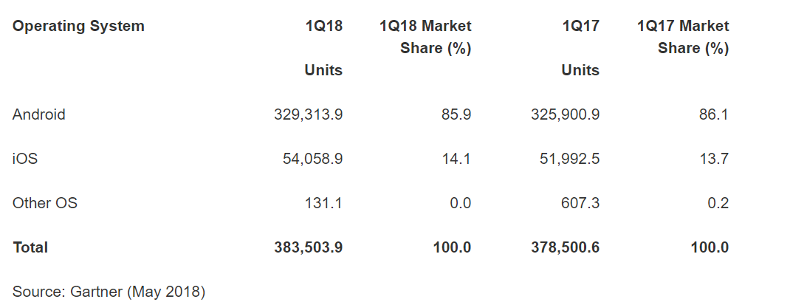
Why Android?
https://www.gartner.com/newsroom/id/3876865

Slide 3
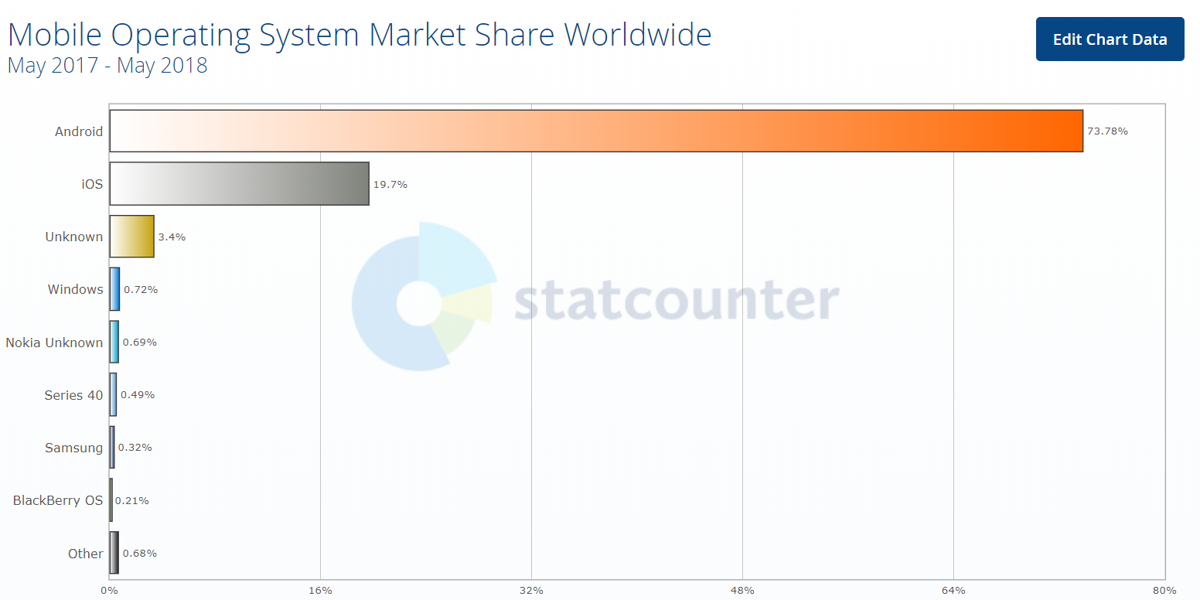
Why Android?
http://gs.statcounter.com/os-market-share/mobile/worldwide/#monthly-201705-201805-bar

Slide 4
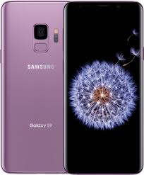

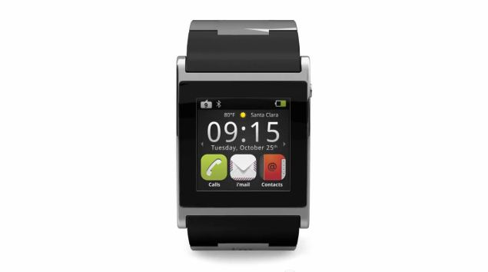

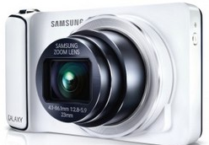
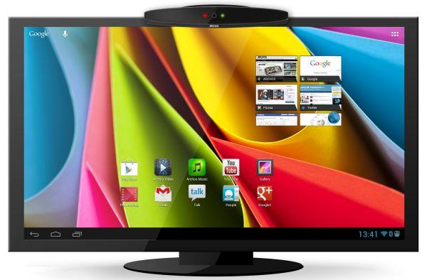
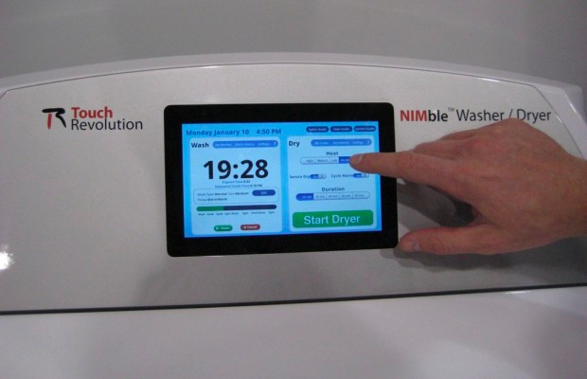
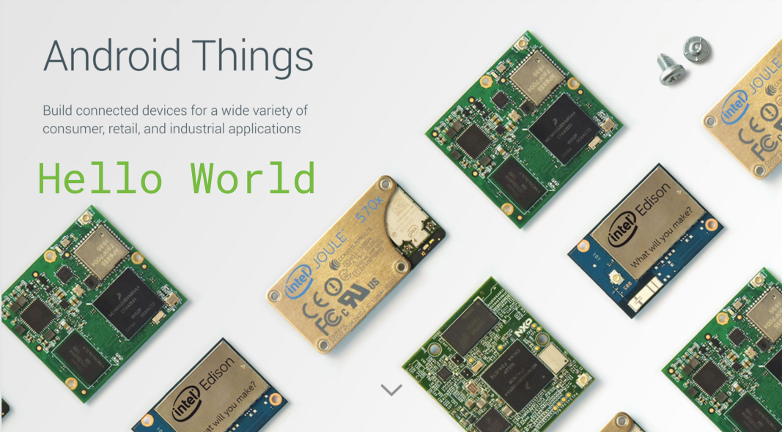
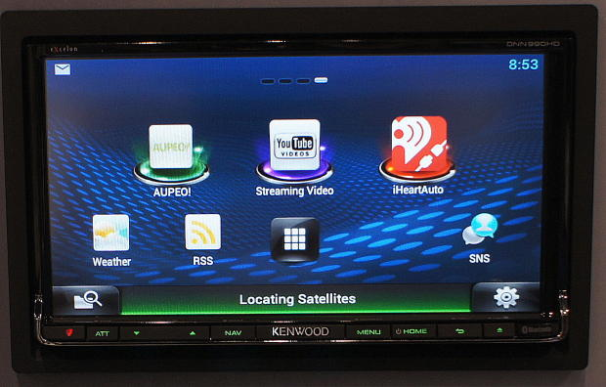

Why Android?
Tablet
Microwave
oven
Watch
Camera
Phone
Laundry
Machine
TV
Things
Car

Slide 5

Android History. Before Android
General Magic, engineer, 1992–1995
MSN TV, engineer, 1995–1999
Andrew E. Rubin

Slide 6
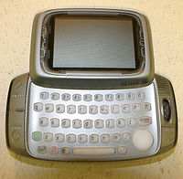
Android History. Before Android
Danger Inc., co-founder, 1999–2003
Android Inc., A. Rubin was co-founder
2003–2005. Android was acquired by Google in 2005
Danger Hiptop

Slide 7
Android History
2005
Google acquires startup Android Inc. to start Android platform
Work on Dalvik VM begins
2007
Open Handset Alliance announced
Early look at SDK
2008
Google sponsors 1st Android Developer Challenge
T-Mobile G1 announced
SDK 1.0 released
Android released open source (Apache License)
Android Dev Phone 1 released

Slide 8
Android History. What is Open Handset Alliance?
Quoting from www.OpenHandsetAlliance.com page
“… Open Handset Alliance™, a group of 47 technology and mobile companies have come together to accelerate innovation in mobile and offer consumers a richer, less expensive, and better mobile experience.
Together we have developed Android™, the first complete, open, and free mobile platform.
We are committed to commercially deploy handsets and services using the Android Platform. “

Slide 9
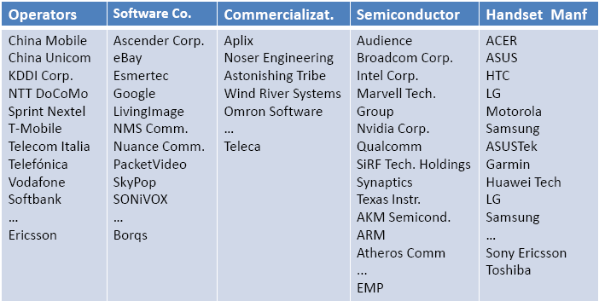
Android History. What is Open Handset Alliance?

Slide 10

Android History. What is Open Handset Alliance?

Slide 11
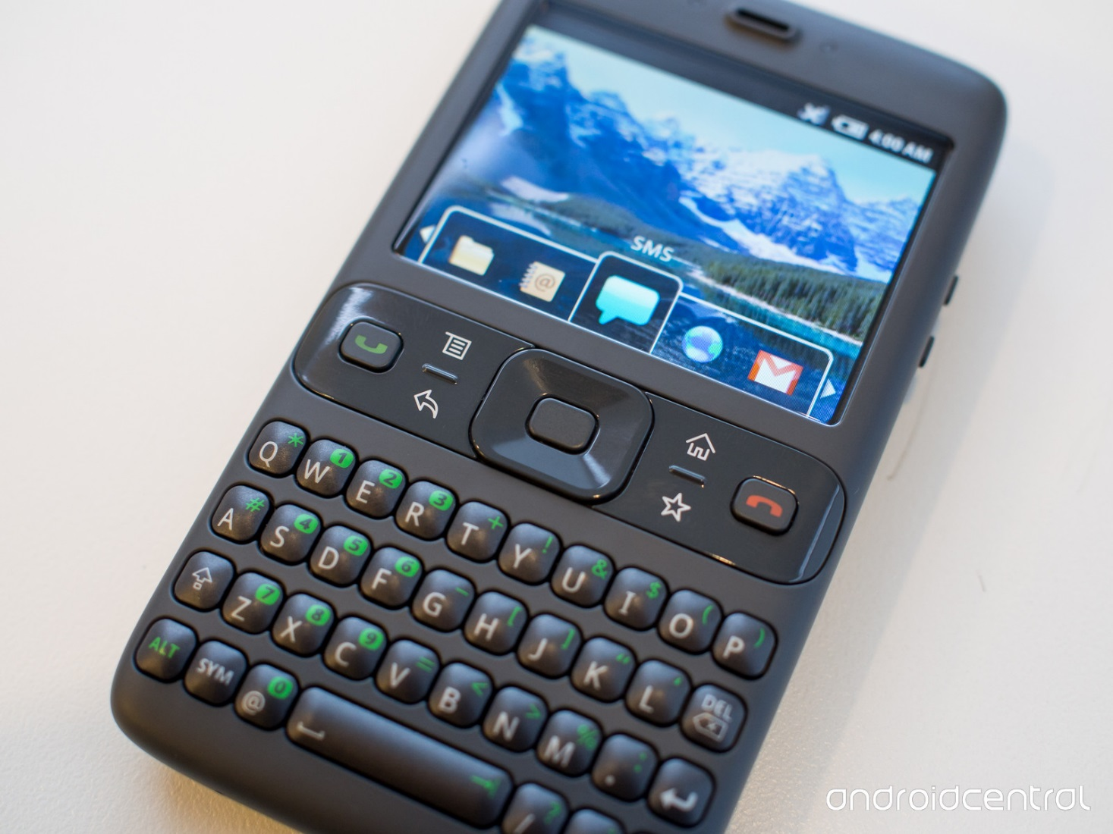
Android History
The "Sooner" prototype phone,running a pre-release version of Android
Display 320 x 240,
Camera 1,3 Мp,
RAM 64 M,
GPRS,
SD-card

Slide 12
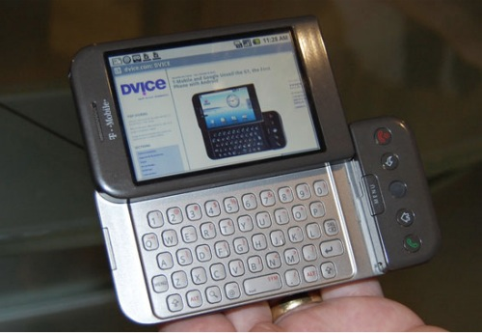
Android History
HTC Dream (T-Mobile G1), 2008.09.23.

Slide 13
Android History
2009
SDK 1.5 (Cupcake)
New soft keyboard with “autocomplete” feature
SDK 1.6 (Donut)
Support Wide VGA
SDK 2.0/2.0.1/2.1 (Eclair)
Revamped UI, browser
2010
Nexus One released to the public
SDK 2.2 (Froyo)
Flash support, tethering
SDK 2.3 (Gingerbread)
UI update, system-wide copy-paste
…………………

Slide 14
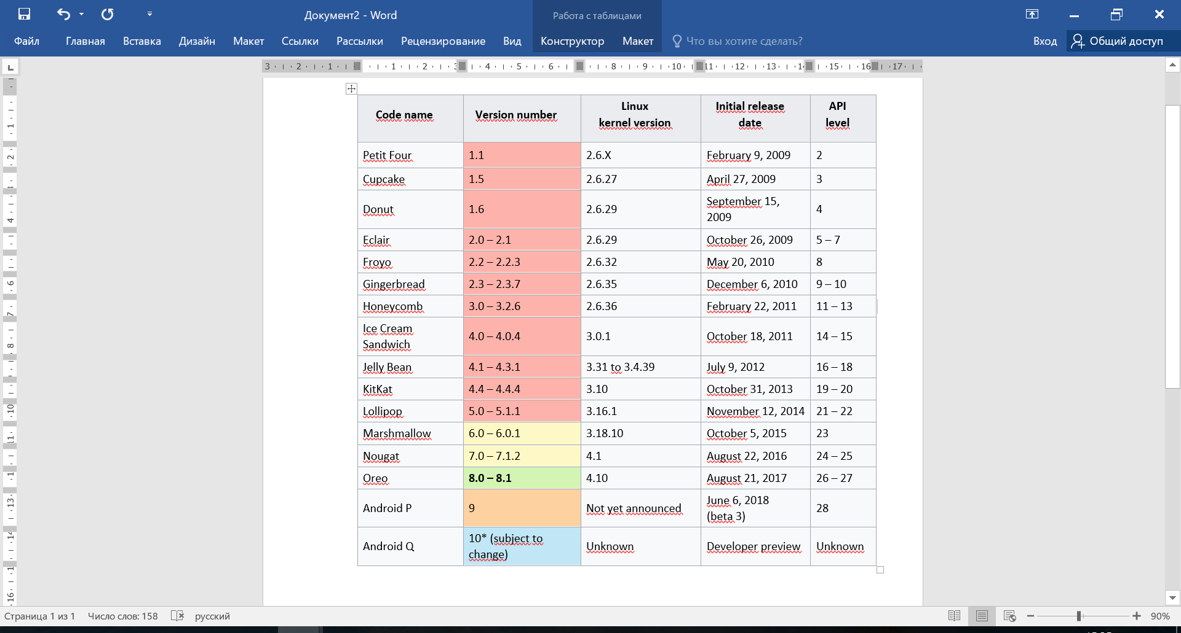
Android History

Slide 15
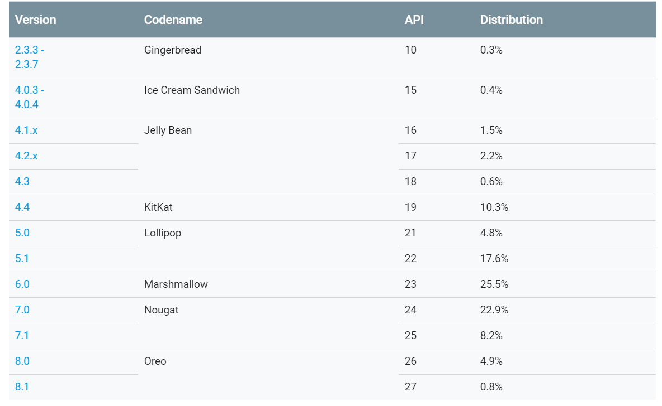
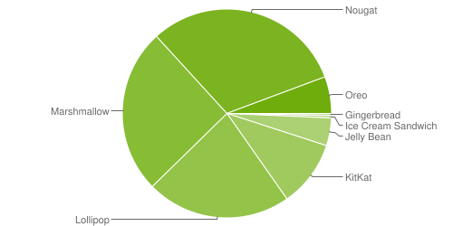
Android History

Slide 16
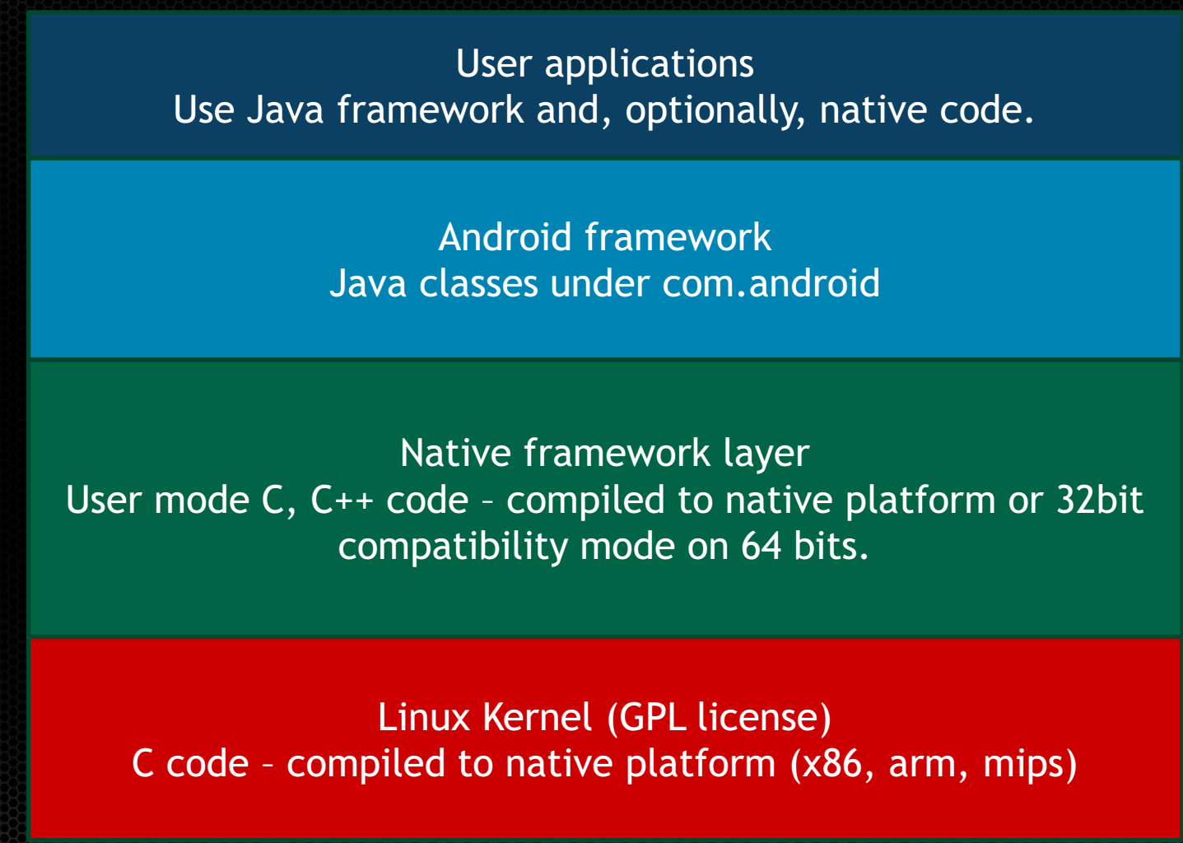
Android Internals

Slide 17
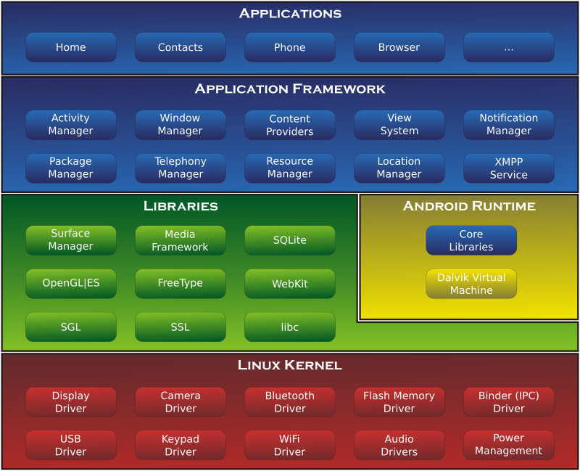
Android Internals

Slide 18
ART vs Dalvik
AOT instead of JIT
Enhanced garbage collector
Application tracing
……..
Question: What means Dalvik?

Slide 19
How to build mobile application
Mobile Application
Web site
Web view
Hybrid
Native
Android SDK
(Java or Kotlin)
Android NDK
(C++)

Slide 20
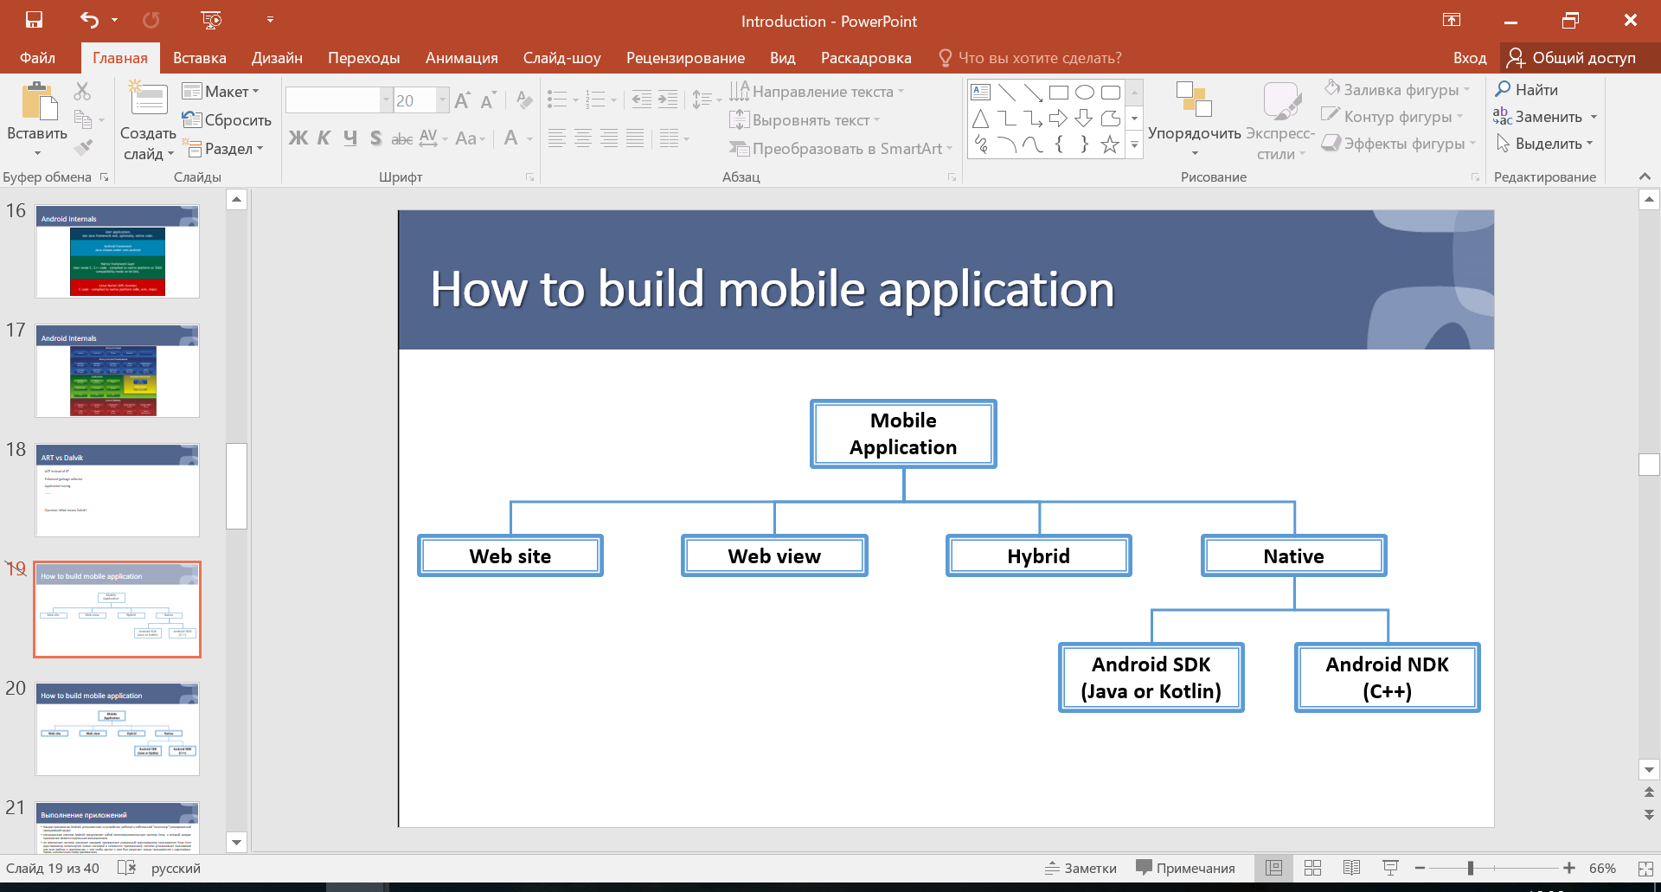
How to build mobile application

Slide 21
Building process
Java Source
Android Manifest
Generated Class
Java Compiler
.dex
File
Dalvik
VM
Resource XML
Android Libraries

Slide 22
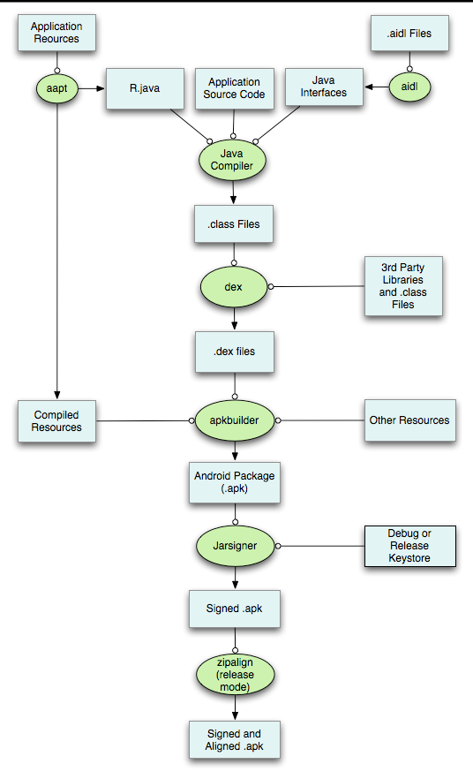
Building process

Slide 23
Application Building Blocks
Activity
Intent
Service
Content Provider
Broadcast Receiver
Fragments
Manifest
Resources
Icons
Sounds
Pictures
Strings
Layouts
…..

Slide 24
Application Building Blocks
Activity
Typically correspond to one UI screen
But, they can:
Be faceless
Be in a floating window
Return a value

Slide 25
Application Building Blocks
Intent
Think of Intents as a verb and object; a description of what you want done
E.g. VIEW, CALL, PLAY etc..
System matches Intent with Activity that can best provide the service
Intent can start other Activity or Service and transmit data

Slide 26









Application Building Blocks
Intent
Home
Photo Gallery
Contacts
Picasa
“Pick photo”
GMail
Chat
Blogger
Blogger

Slide 27
Application Building Blocks
Services
Faceless components that run in the background
E.g. music player, network download etc…

Slide 28
Application Building Blocks
ContentProviders
Enables sharing of data across applications
E.g. address book, photo gallery
Provides uniform APIs for:
querying
delete, update and insert.
Content is represented by URI and MIME type

Slide 29
Application Building Blocks
BroadcastReceivers
Components that respond to broadcast ‘Intents’
Way to respond to external notification or alarms
(for ex., Battery is low)
Apps can invent and broadcast their own Intent

Slide 30
Application Execution
By default, each app is run in its own Linux process
Process started when app’s code needs to be executed
Threads can be started to handle time-consuming operations
Each process has its own VM
By default, each app is assigned unique Linux ID
Permissions are set so app’s files are only visible to that app

Slide 31
How to become a developer
Download Android Studio from https://developer.android.com/
Install SDK for your platform
Configure Emulator
Install Drivers
Enable your phone

Slide 32
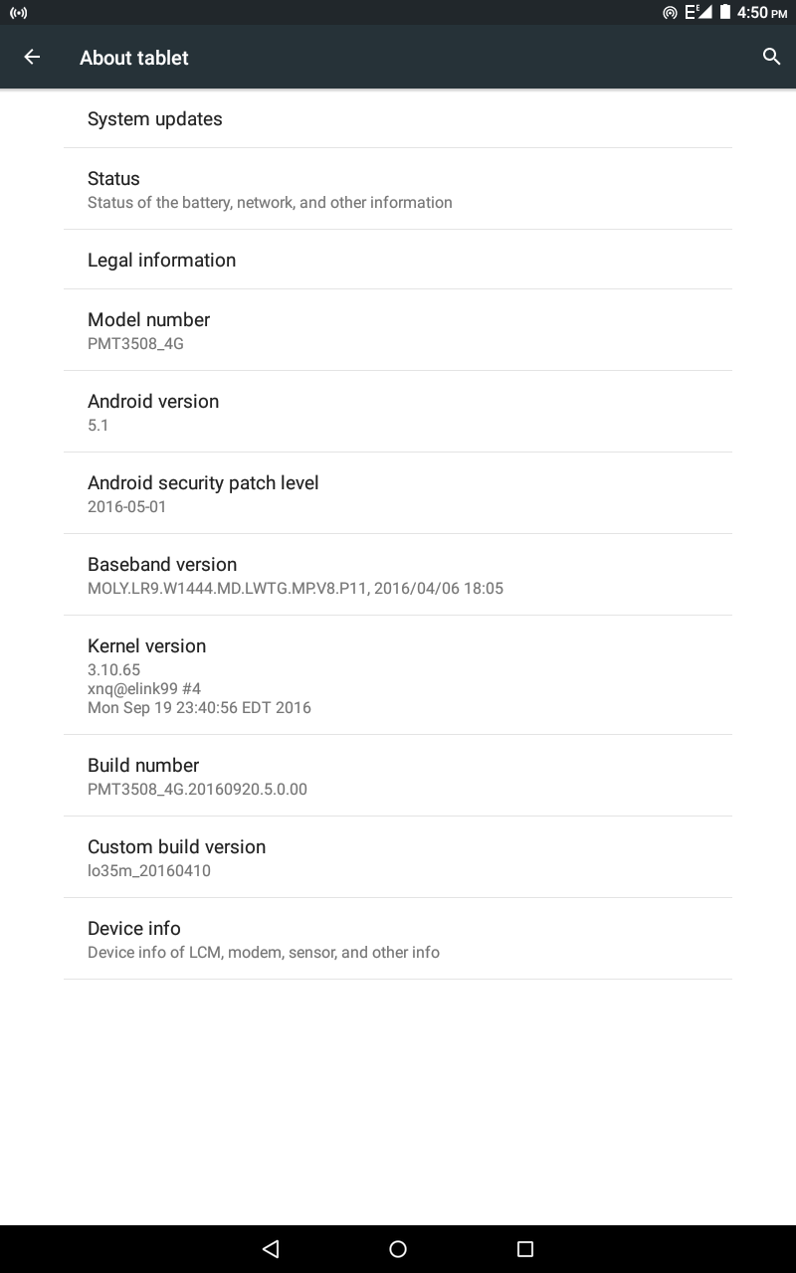
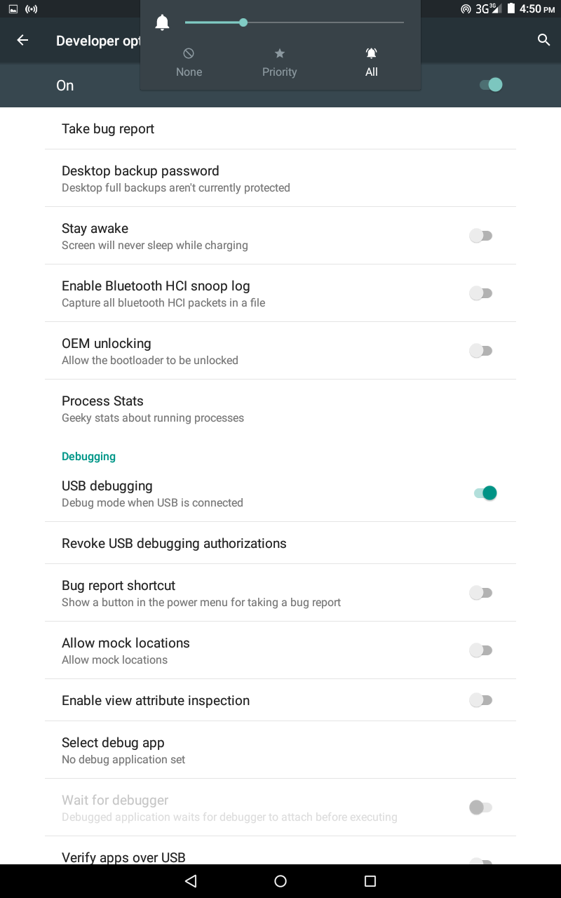
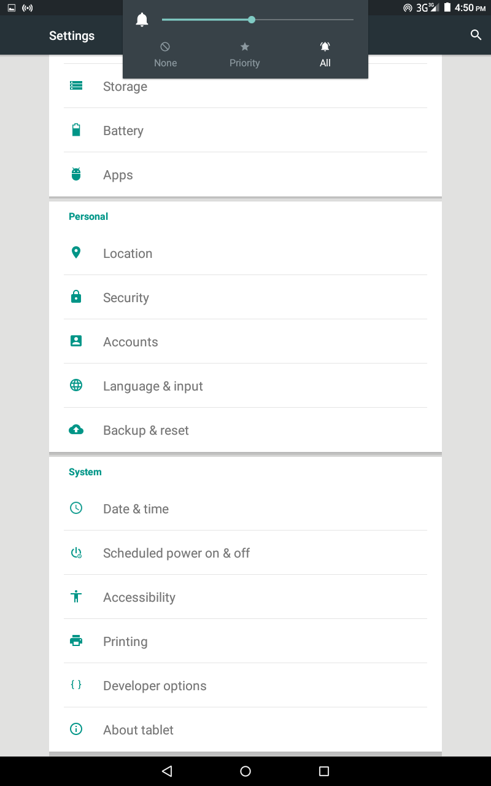
How to become a developer
Tap 7 times

Slide 33
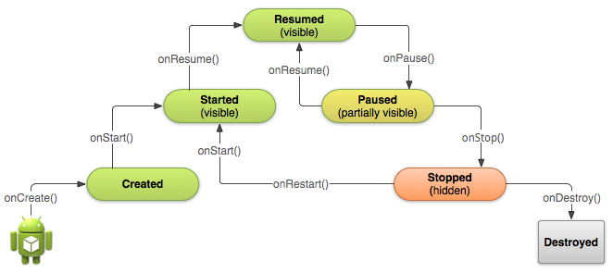
Activity Life Cycle

Slide 34
Activity Life Cycle
onCreate()
You must implement this callback, which fires when the system first creates the activity. On activity creation, the activity enters the Created state. In the onCreate() method, you perform basic application startup logic that should happen only once for the entire life of the activity. For example, your implementation of onCreate() might bind data to lists, associate the activity with a ViewModel, and instantiate some class-scope variables. This method receives the parameter savedInstanceState, which is a Bundle object containing the activity's previously saved state. If the activity has never existed before, the value of the Bundle object is null.
If you have a lifecycle-aware component that is hooked up to the lifecycle of your activity it will receive the ON_CREATE event. The method annotated with @OnLifecycleEvent will be called so your lifecycle-aware component can perform any setup code it needs for the created state.

Slide 35
Activity Life Cycle
onStart()
When the activity enters the Started state, the system invokes this callback. The onStart() call makes the activity visible to the user, as the app prepares for the activity to enter the foreground and become interactive. For example, this method is where the app initializes the code that maintains the UI.
When the activity moves to the started state, any lifecycle-aware component tied to the activity's lifecycle will receive the ON_START event.
The onStart() method completes very quickly and, as with the Created state, the activity does not stay resident in the Started state. Once this callback finishes, the activity enters the Resumed state, and the system invokes the onResume() method.

Slide 36
Activity Life Cycle
onResume()
When the activity enters the Resumed state, it comes to the foreground, and then the system invokes the onResume() callback. This is the state in which the app interacts with the user. The app stays in this state until something happens to take focus away from the app. Such an event might be, for instance, receiving a phone call, the user’s navigating to another activity, or the device screen’s turning off.
When the activity moves to the resumed state, any lifecycle-aware component tied to the activity's lifecycle will receive the ON_RESUME event. This is where the lifecycle components can enable any functionality that needs to run while the component is visible and in the foreground, such as starting a camera preview.
When an interruptive event occurs, the activity enters the Paused state, and the system invokes the onPause() callback.
If the activity returns to the Resumed state from the Paused state, the system once again calls onResume() method. For this reason, you should implement onResume() to initialize components that you release during onPause(), and perform any other initializations that must occur each time the activity enters the Resumed state

Slide 37
Activity Life Cycle
onPause()
The system calls this method as the first indication that the user is leaving your activity (though it does not always mean the activity is being destroyed); it indicates that the activity is no longer in the foreground (though it may still be visible if the user is in multi-window mode). Use the onPause() method to pause or adjust operations that should not continue (or should continue in moderation) while the Activity is in the Paused state, and that you expect to resume shortly.
In Android 7.0 (API level 24) or higher, multiple apps run in multi-window mode. Because only one of the apps (windows) has focus at any time, the system pauses all of the other apps.
A new, semi-transparent activity (such as a dialog) opens. As long as the activity is still partially visible but not in focus, it remains paused.
When the activity moves to the paused state, any lifecycle-aware component tied to the activity's lifecycle will receive the ON_PAUSE event. This is where the lifecycle components can stop any functionality that does not need to run while the component is not in the foreground, such as stopping a camera preview.
You can also use the onPause() method to release system resources, handles to sensors (like GPS), or any resources that may affect battery life while your activity is paused and the user does not need them. However, as mentioned above in the onResume() section, a Paused activity may still be fully visible if in multi-window mode. As such, you should consider using onStop() instead of onPause() to fully release or adjust UI-related resources and operations to better support multi-window mode.

Slide 38
Activity Life Cycle
onStop()
When your activity is no longer visible to the user, it has entered the Stopped state, and the system invokes the onStop() callback. This may occur, for example, when a newly launched activity covers the entire screen. The system may also call onStop() when the activity has finished running, and is about to be terminated.
When the activity moves to the stopped state, any lifecycle-aware component tied to the activity's lifecycle will receive the ON_STOP event. This is where the lifecycle components can stop any functionality that does not need to run while the component is not visible on the screen.
In the onStop() method, the app should release or adjust resources that are not needed while the app is not visible to the user. For example, your app might pause animations or switch from fine-grained to coarse-grained location updates. Using onStop() instead of onPause() ensures that UI-related work continues, even when the user is viewing your activity in multi-window mode.
You should also use onStop() to perform relatively CPU-intensive shutdown operations. For example, if you can't find a more opportune time to save information to a database, you might do so during onStop().

Slide 39
Activity Life Cycle
onDestroy()
onDestroy() is called before the activity is destroyed. The system invokes this callback either because:
the activity is finishing (due to the user completely dismissing the activity or due to finish() being called on the activity), or
the system is temporarily destroying the activity due to a configuration change (such as device rotation or multi-window mode).
When the activity moves to the stopped state, any lifecycle-aware component tied to the activity's lifecycle will receive the ON_DESTROY event. This is where the lifecycle components can clean up anything it needs to before the Activity is destroyed.
You can distinguish between these two scenarios with the isFinishing() method.
If the activity is finishing, onDestroy() is the final lifecycle callback the activity receives. If onDestroy() is called as the result of a configuration change, the system immediately creates a new activity instance and then calls onCreate() on that new instance in the new configuration.
The onDestroy() callback should release all resources that have not yet been released by earlier callbacks such as onStop().

